Slide 1
Cloud Design Patterns AZURE SQL ,NOSQL & AZURE COSMOS DB & FUNCTION APPS, LOGIC APPS & ACI, ACR

Slide 2
Cloud Design Patterns:
These design patterns are useful for building reliable, scalable, secure applications in the cloud.
Each pattern describes the problem that the pattern addresses, considerations for applying the pattern, and an example based on Microsoft Azure.

Slide 3
Cloud Design Patterns are 2 types.
1. Cache-Aside pattern
2. Sharding pattern
Cache-Aside pattern :
Load data on demand into a cache from a data store. This can improve performance and also helps to maintain consistency between data held in the cache and data in the underlying data store.

Slide 4
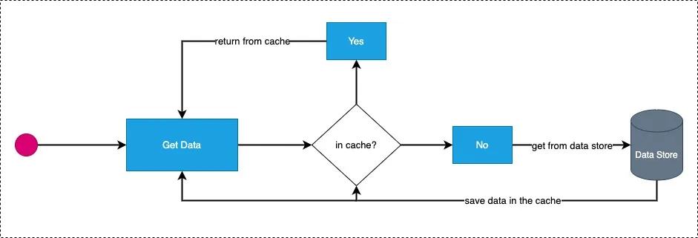
Cache-Aside pattern

Slide 5
2. Sharding pattern :
A shard is a data store in its own right (it can contain the data for many entities of different types), running on a server acting as a storage node.
Divide a data store into a set of horizontal partitions or shards. This can improve scalability when storing and accessing large volumes of data.

Slide 6
Here are TWO common sharding strategies
1. Vertical Scaling Sharding. (Scale up ↑)
2. Horizontal Scaling Sharding. (Scale out →→)
Vertical Scaling Sharding. (Scale up ↑) :
Increase RAM or Storage Capacity and
improve CPU Capacity.
2. Horizontal Scaling Sharding. (Scale out →→) :
This spreads the workload of a given database across multiple database servers

Slide 7
Sharding Manager :
The shard map manager is a special database that maintains global mapping information about all shards (databases) in a shard set. The metadata allows an application to connect to the correct database based upon the value of the sharding key.
RDS (Relational Database Service) :
Relational databases are a type of database that store and organize data points with defined relationships for fast access.
With a relational database, data is organized into tables that hold information about each entity and represent pre-defined categories through rows and columns.

Slide 8
SQL :
SQL is a Structured Query Language
SQL is the programming language used to interface with relational databases. (Relational databases model data as records in rows and tables with logical links between them)
SQL database are Table based.
SQL is vertical scalable.
SQL is Static Schema

Slide 9
NOSQL :
NoSQL, also referred to as “not only SQL”, “non-SQL”
NoSQL is a class of DBMs that are non-relational and generally do not use SQL
NoSQL, the Non-Relational DB is classified under Key-Value pair, Document Oriented type, Column family, and Graph.
NoSQL is Horizontally Scalable.

Slide 10
Azure SQL
Azure SQL Database is an always-up-to-date, fully managed relational database service built for the cloud.
Azure SQL Database is a fully managed platform as a service (PaaS) database engine that handles most of the database management functions such as upgrading, patching, backups, and monitoring without user involvement.

Slide 11
Lab1: Create Azure SQL Database Server
In AZURE SQL, Browse to the Select SQL Deployment option Under SQL databases, leave Resource type set to SQL database server, and select Create.
On the Basics tab of the Create SQL Database form, under Project details, select the desired Azure Subscription.
For Resource group, select Create new, enter manoj-rg, and select OK.
For server name, enter manoj-server1.

Slide 12
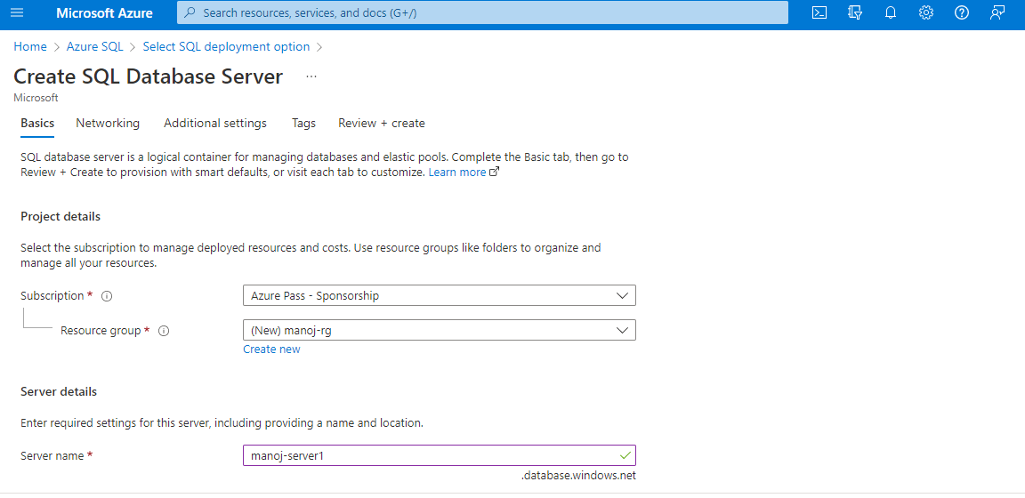

Slide 13
Authentication method: Select Use SQL authentication.
Server admin login: Enter vm.
Password: Enter a password that meets requirements, and enter it again in the Confirm password field.
Select OK.
After Validation is passed .Then create and go to resource.

Slide 14
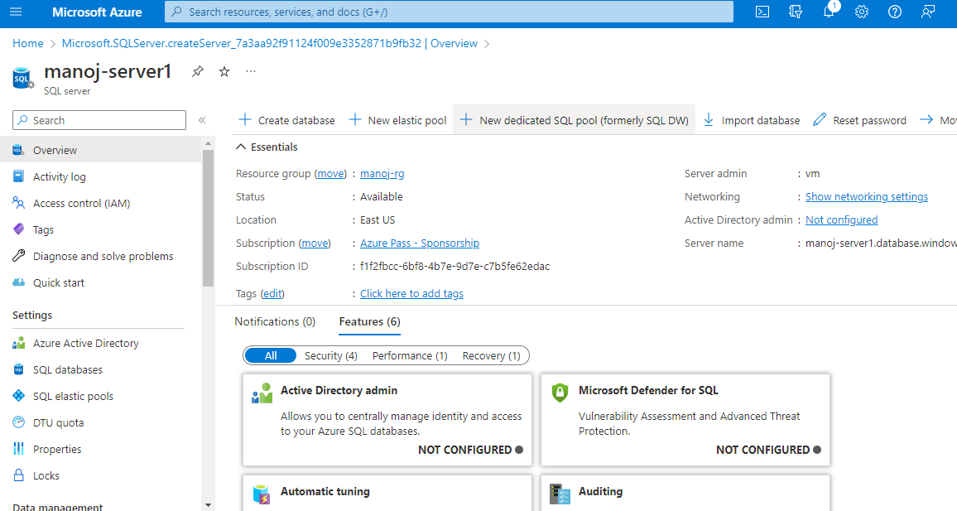

Slide 15
In the manoj-server1 click the create database.
On the Basics tab of the Create SQL Database form, under Project details, select the desired Azure Subscription.
For Resource group, select Create new, enter manoj-rg, and select OK.
For Database name, enter manoj-db.

Slide 16
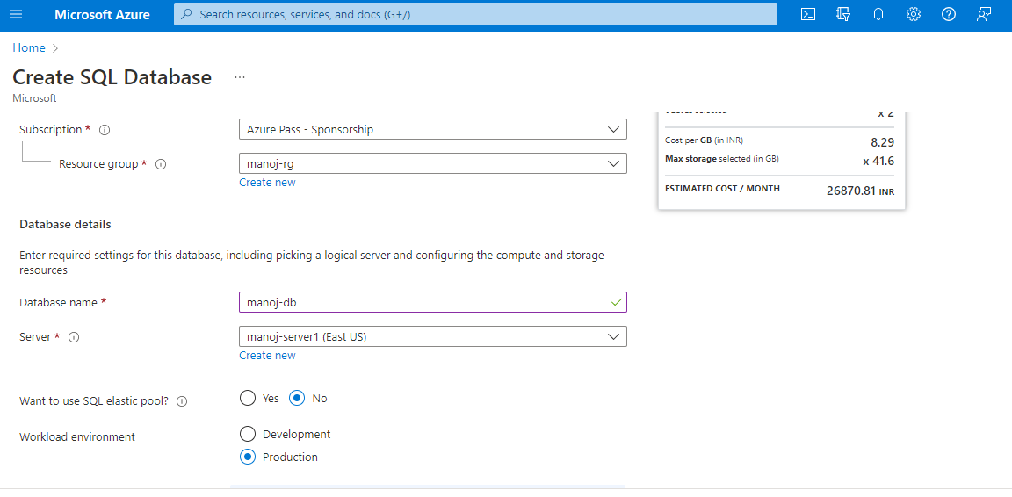

Slide 17
Leave Want to use SQL elastic pool set to No.
Under Compute + storage, select Configure database.
This quickstart uses a serverless database, so leave Service tier set to General Purpose (Scalable compute and storage options) and set Compute tier to Serverless. Select Apply.

Slide 18
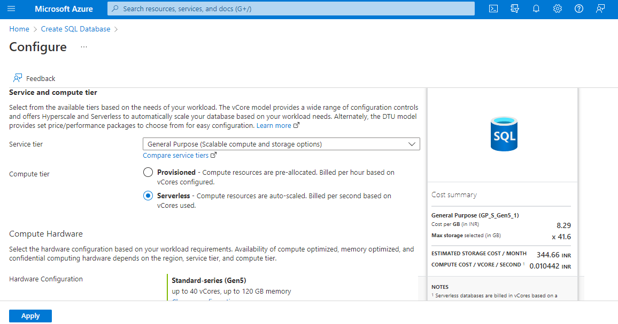

Slide 19
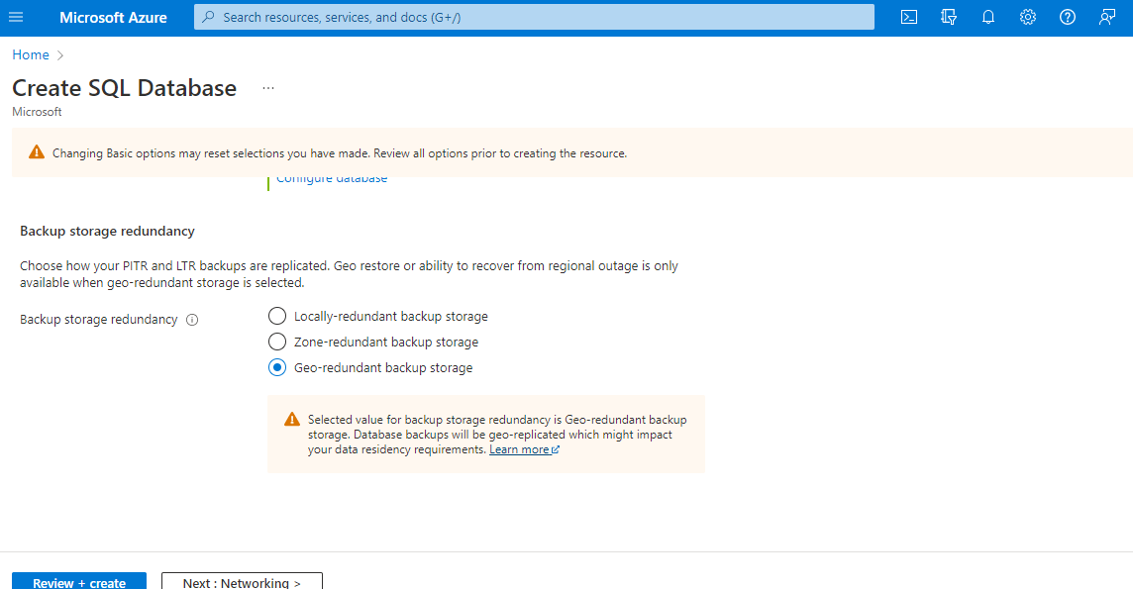
Select Next: Networking at the bottom of the page.

Slide 20
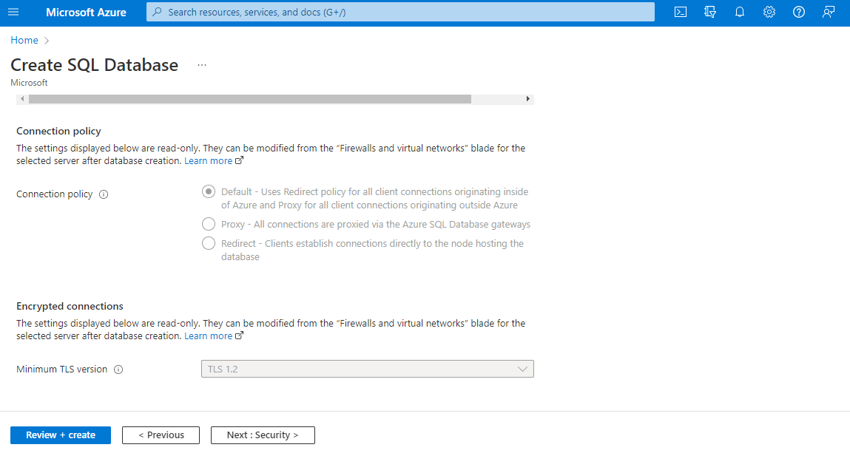
On the Networking tab, for Connectivity method, select Public endpoint.
For Firewall rules, set Add current client IP address to Yes. Leave Allow Azure services and resources to access this server set to No.

Slide 21
On the Security page,
On the Additional settings tab, in the Data source section, for Use existing data, select Sample. This creates an AdventureWorksLT sample database so there's some tables and data to query and experiment with, as opposed to an empty blank database
Select Review + create at the bottom of the page:

Slide 22
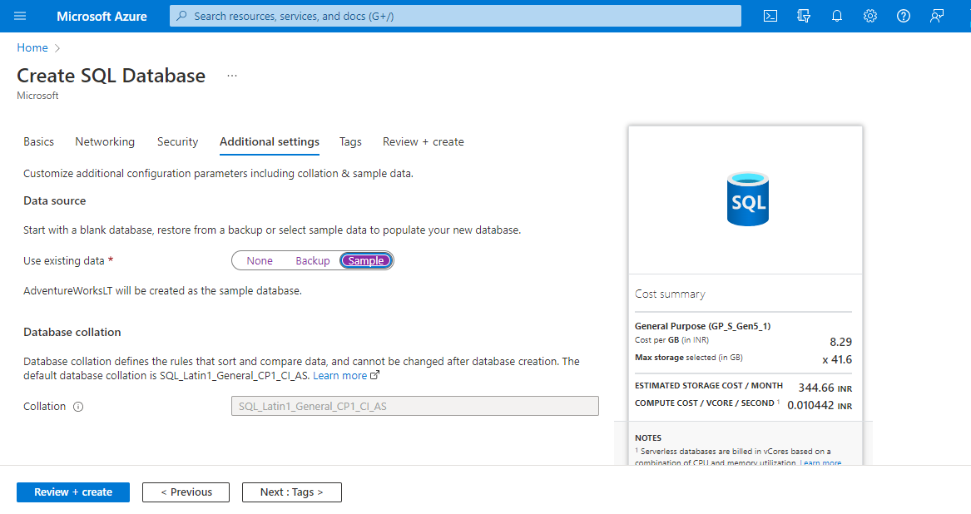

Slide 23
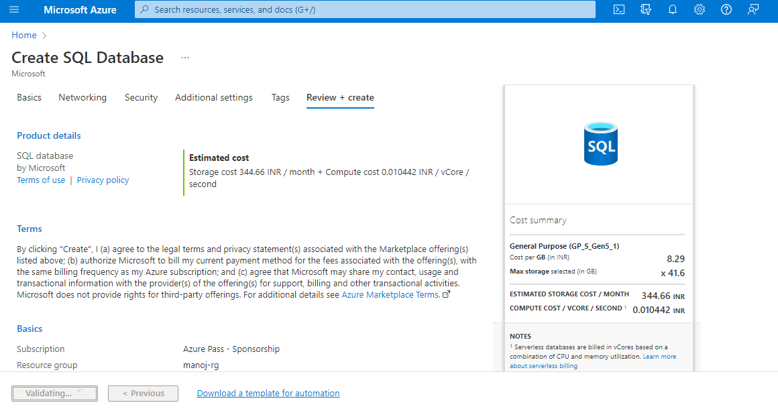

Slide 24
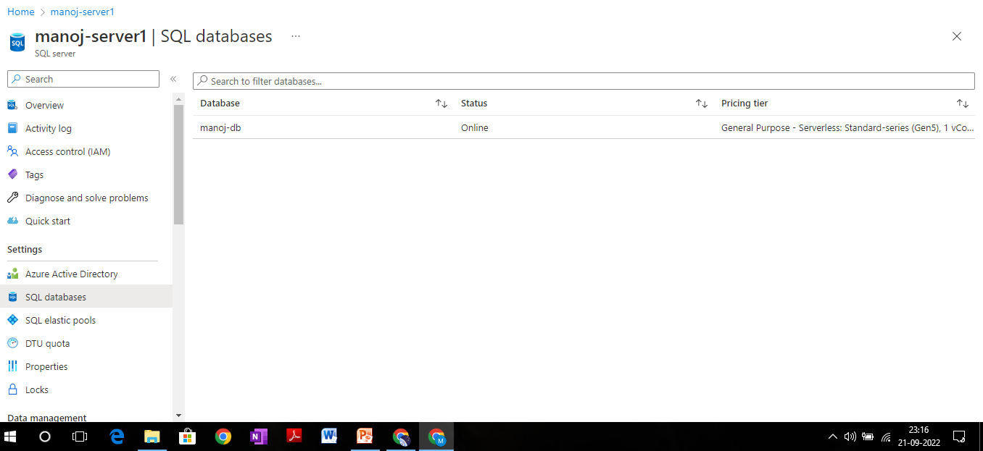

Slide 25
AZURE FUNCTION APP
Azure function app :
Azure Functions is a cloud service available on-demand that provides all the continually updated infrastructure and resources needed to run your applications. You focus on the pieces of code that matter most to you, and Functions handles the rest. Functions provides serverless compute for Azure.
A function app is a collection of one or more functions that are managed together. All the functions in a Function App share the same pricing plan and it can be a consumption plan or an App Service plan

Slide 26
Lab2 : Create Azure Function App
From the Azure portal menu or the Home page, select Create a resource.
In the New page, select Compute > Function App.
On the Basics page, use the function app settings as specified in the following :

Slide 27
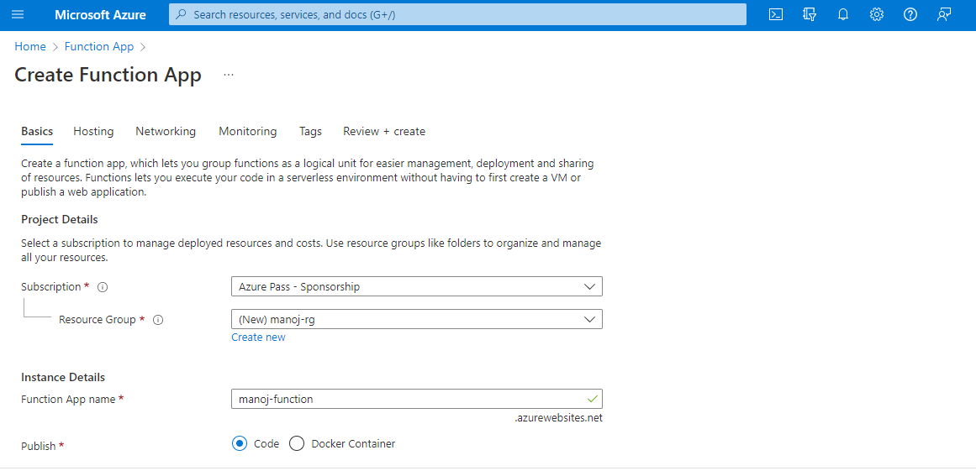

Slide 28
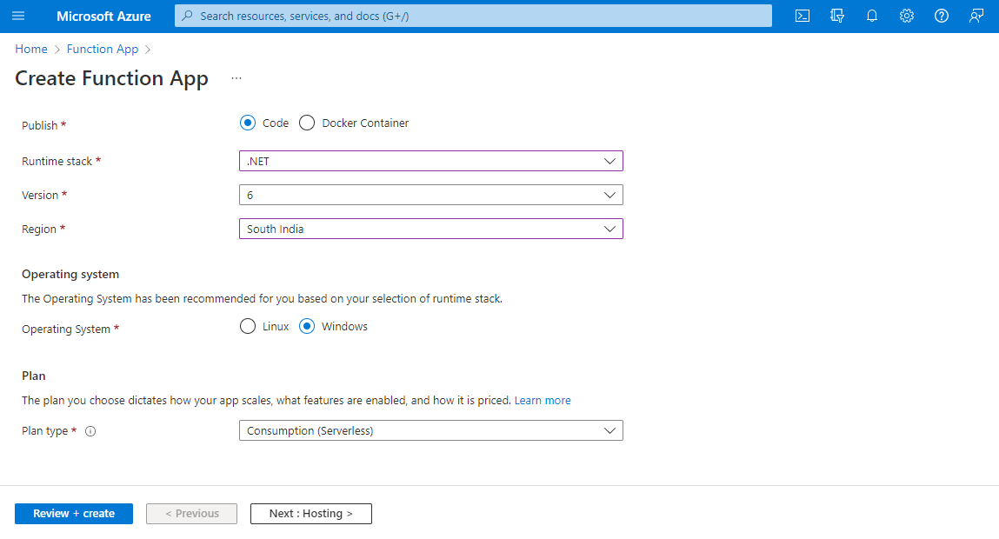

Slide 29
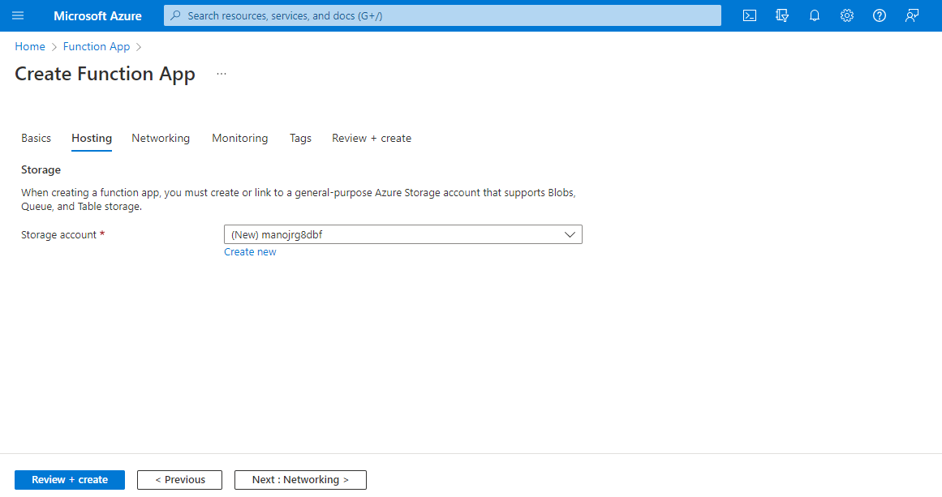
Select Next : Hosting. On the Hosting page, enter the following settings:

Slide 30
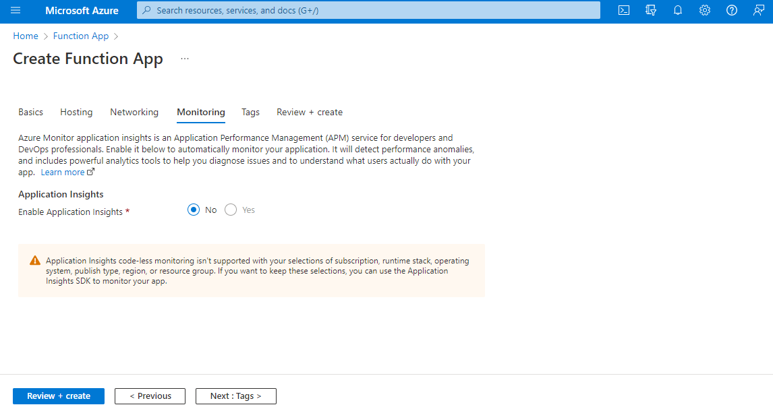
Select Next : Monitoring. On the Monitoring page, enter the following settings:

Slide 31
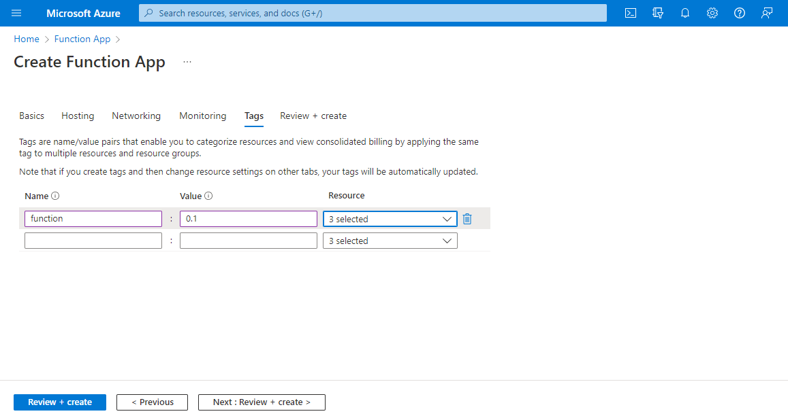

Slide 32
select Review + create to review the app configuration selections.
On the Review + create page, review your settings, and then select Create to provision and deploy the function app.
Select the Notifications icon in the upper-right corner of the portal and watch for the Deployment succeeded message.
Select Go to resource to view your new function app. You can also select Pin to dashboard. Pinning makes it easier to return to this function app resource from your dashboard.

Slide 33
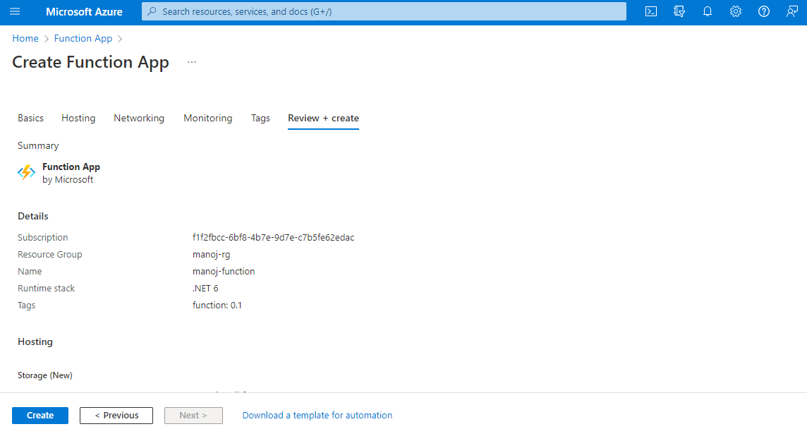

Slide 34
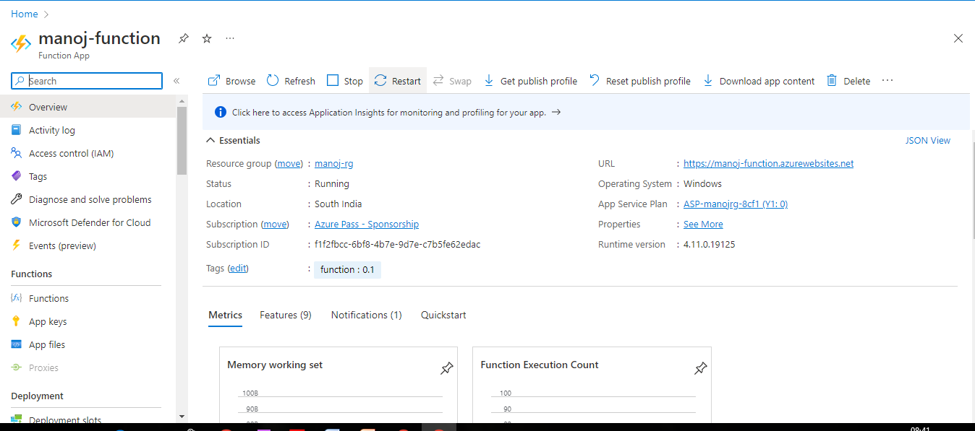

Slide 35
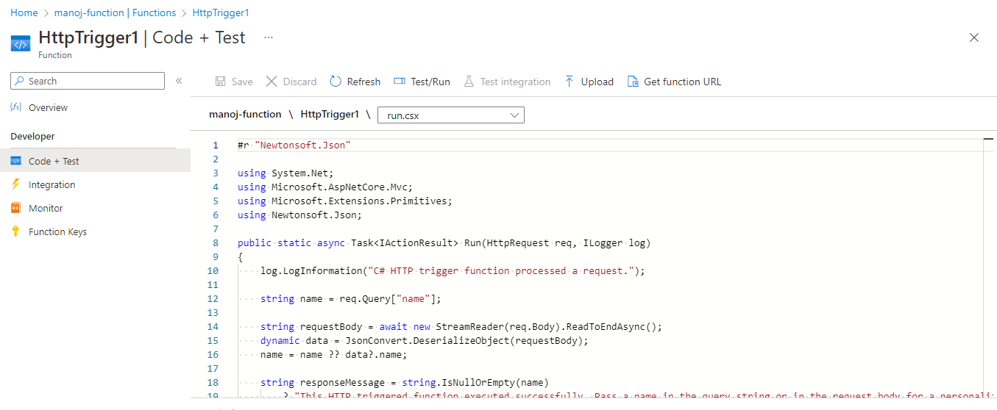
Test the Function
In your new HTTP trigger function, select Code + Test from the left menu, and then select Get function URL from the top menu.

Slide 36
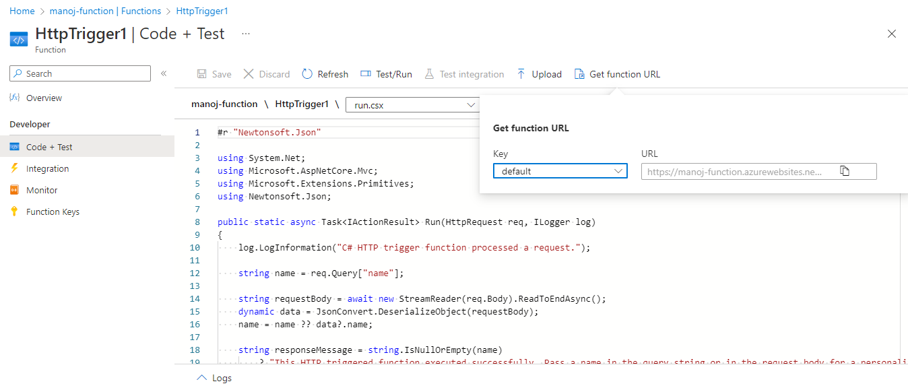
In the Get function URL dialog, select default from the drop-down list, and then select the Copy to clipboard icon.

Slide 37
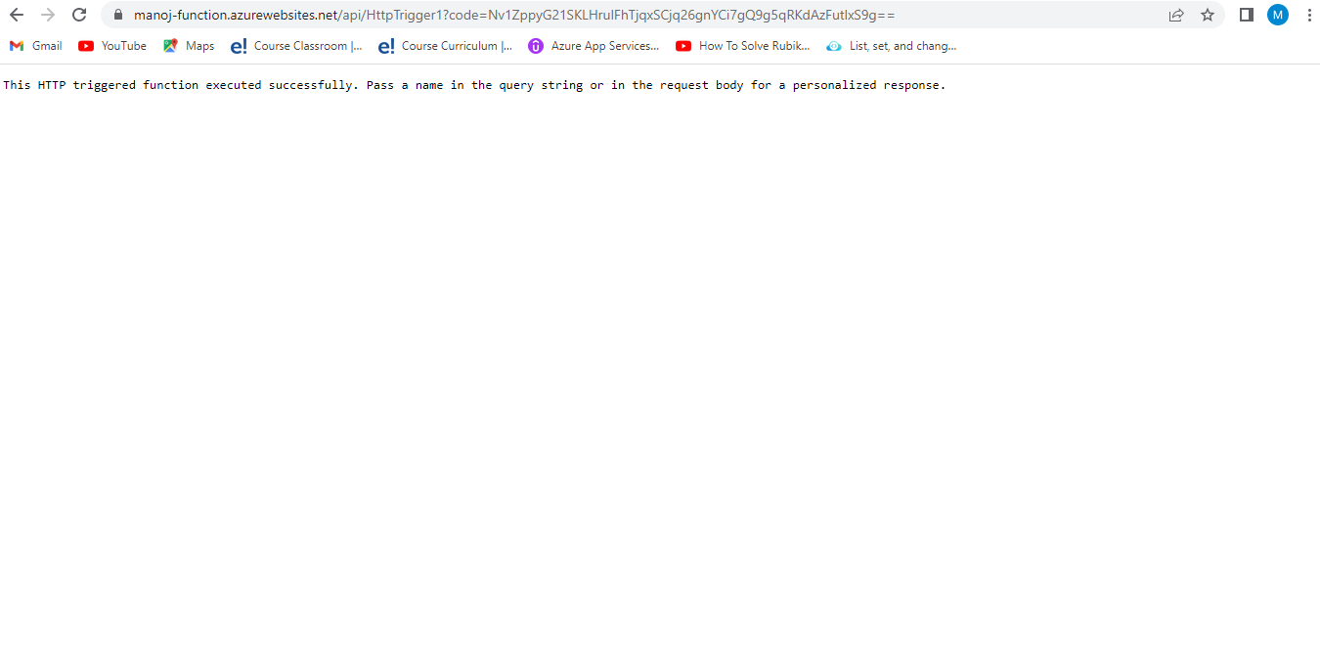

Slide 38
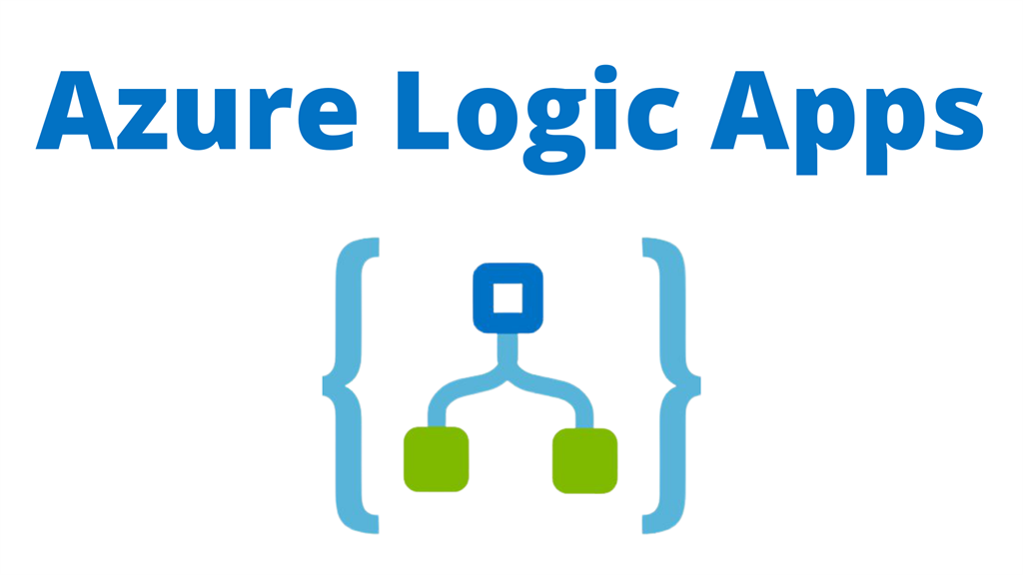

Slide 39
Azure Logic Apps is a cloud-based platform for creating and running automated workflows that integrate your apps, data, services, and systems. With this platform, you can quickly develop highly scalable integration solutions for your enterprise and business-to-business (B2B) scenarios
Azure Logic Apps is a leading integration platform as a service (iPaaS) built on a containerised runtime. Deploy and run Logic Apps anywhere to increase scale and portability while automating business-critical workflows anywhere.

Slide 40
We can use the Azure logic app to automate a common business process that can be shared by multiple applications or enterprises. For example, we can use the logic app to send email notifications to different users when an event happens in various applications, services, and systems, etc.

Slide 41
Lab3: Create Logic App
In the Azure search box, enter logic apps, and select Logic apps.
On the Logic apps page, select Add.
On the Create Logic App pane, on the Basics tab, provide the following basic information about your logic app:

Slide 42
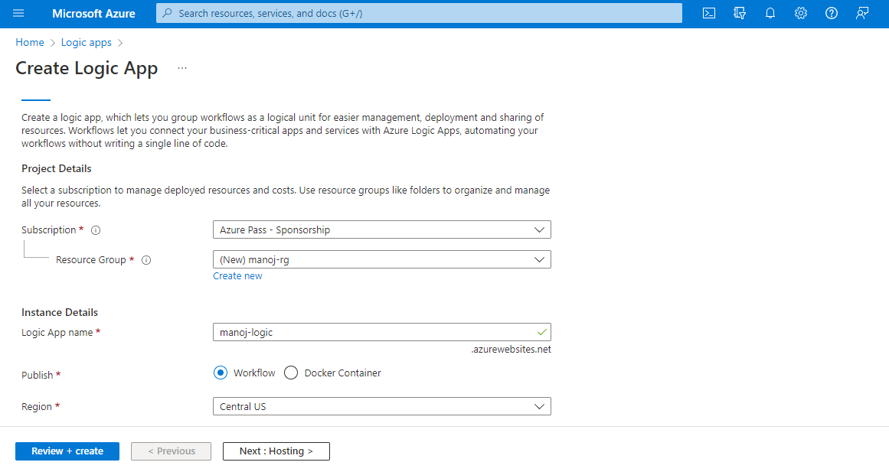

Slide 43
Before you continue making selections, go to the Plan section. For Plan type, select Consumption so that you view only the settings that apply to the Consumption plan-based logic app type. The Plan type property specifies the logic app type and billing model to use.
Consumption:
This logic app type runs in global, multi-tenant Azure Logic Apps and uses the Consumption billing model

Slide 44
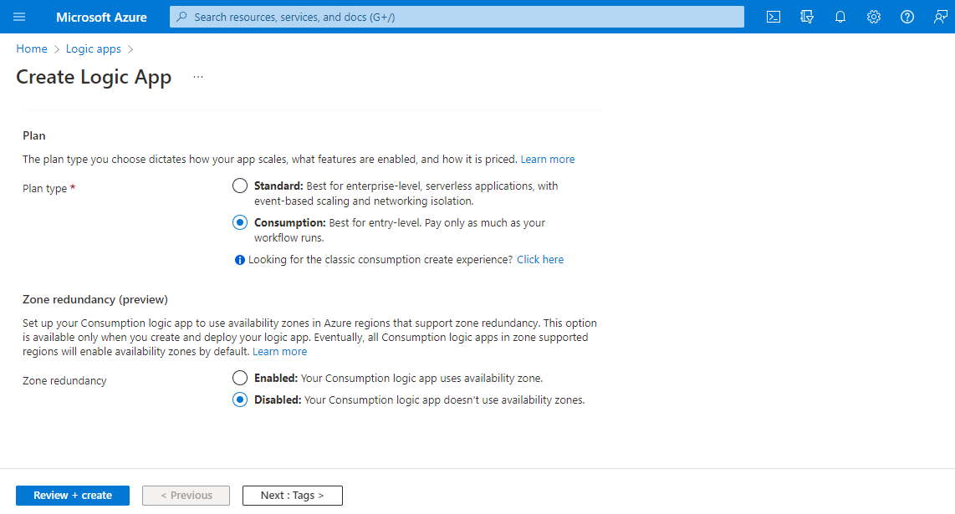

Slide 45
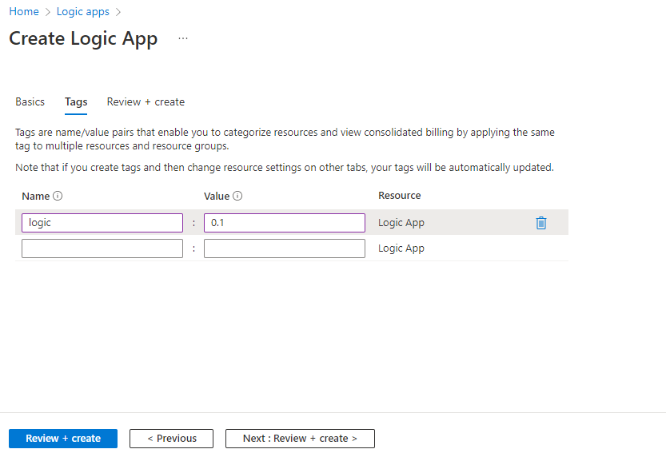

Slide 46
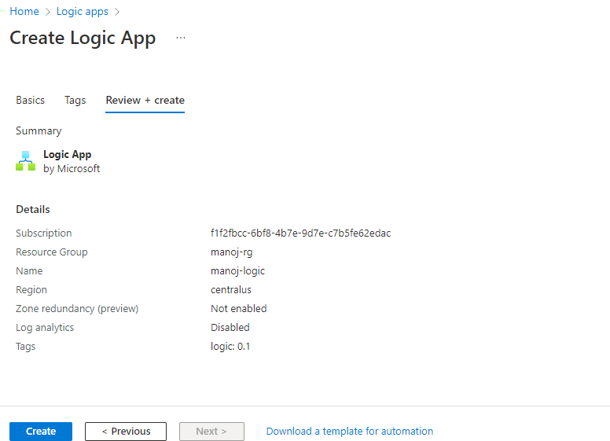
When you're ready, select Review + Create.
On the validation page that appears, confirm all the information that you provided, and select Create.

Slide 47
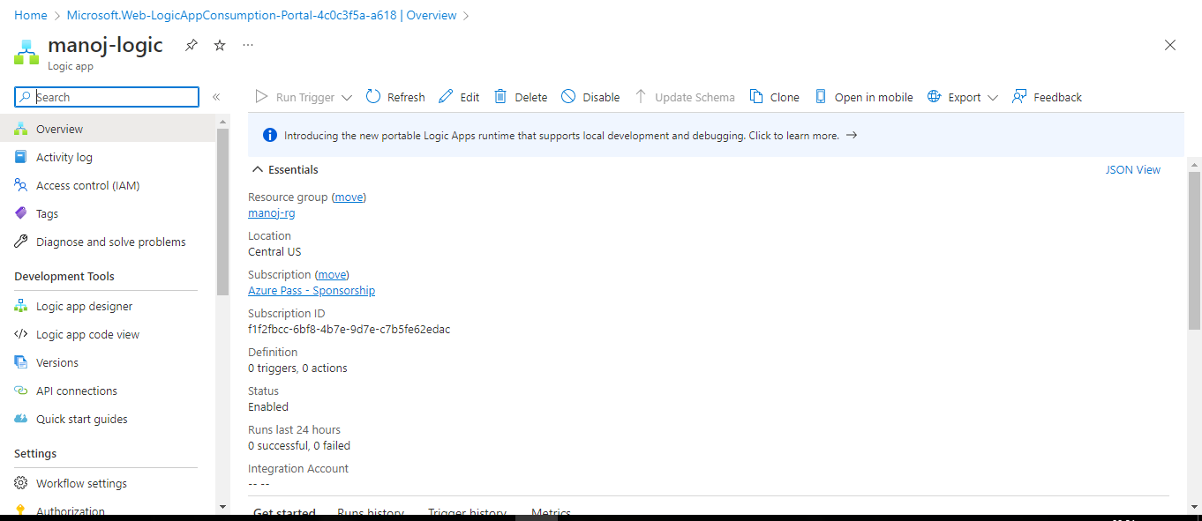

Slide 48

Azure Container Instances

Slide 49
Azure Container Instance :
Containers are becoming the preferred way to package, deploy, and manage cloud applications.
Azure Container Instances offers the fastest and simplest way to run a container in Azure, without having to manage any virtual machines and without having to adopt a higher-level service.
Azure Container Instances is a great solution for any scenario that can operate in isolated containers, including simple applications, task automation, and build jobs.
For scenarios where you need full container orchestration, including service discovery across multiple containers, automatic scaling, and coordinated application upgrades, we recommend Azure Kubernetes Service (AKS)

Slide 50
Lab4: Create Azure Container Instance
On the Azure portal homepage, select Create a resource.
Select Containers > Container Instances.
On the Basics page, choose a subscription and enter the following values for Resource group, Container name, Image source, and Container image.
Resource group: Create new > manoj-rg
Container name: manoj-container
Image source: Quickstart images
Container image: mcr.microsoft.com/azuredocs/aci-helloworld:latest (Linux)

Slide 51
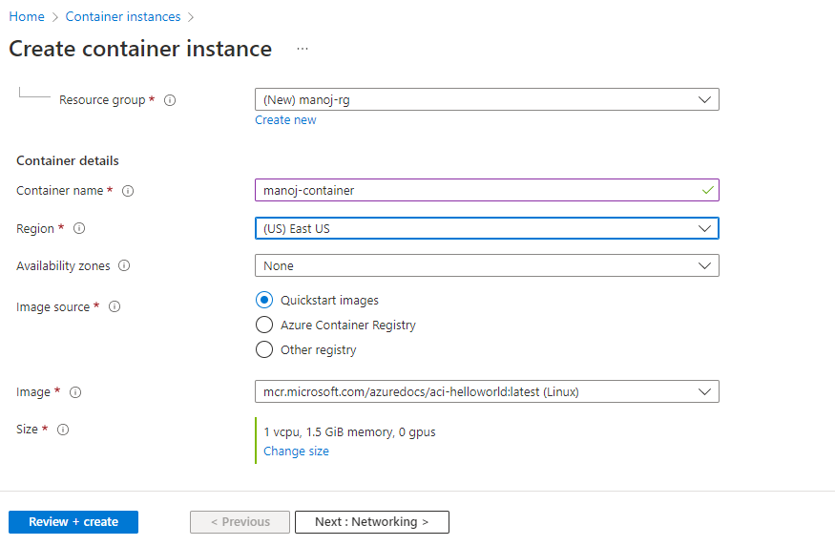

Slide 52
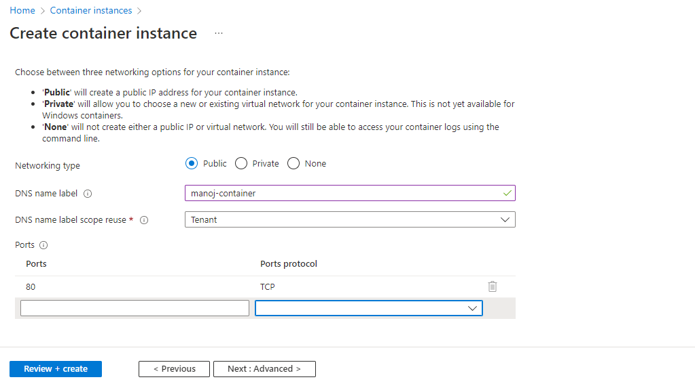
then select Next: Networking.
On the Networking page, specify a DNS name label for your container. The name must be unique within the Azure region where you create the container instance

Slide 53
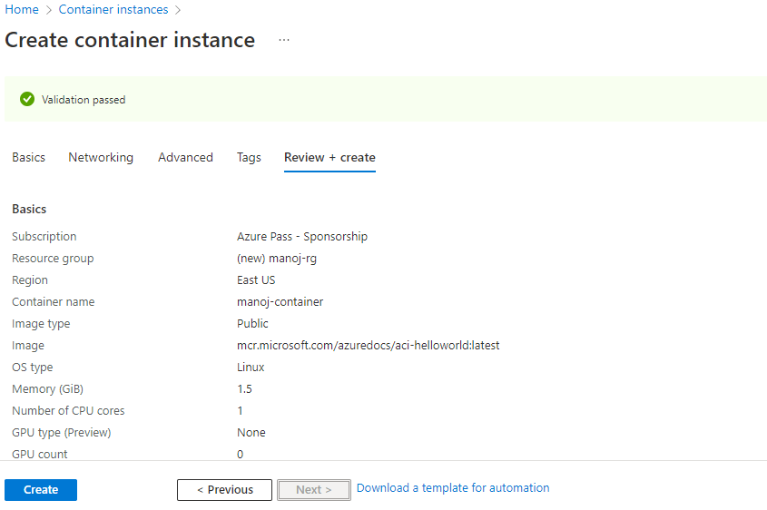
Leave all other settings as their defaults, then select Review + create.
When the validation completes, you're shown a summary of the container's settings. Select Create to submit your container deployment request.

Slide 54
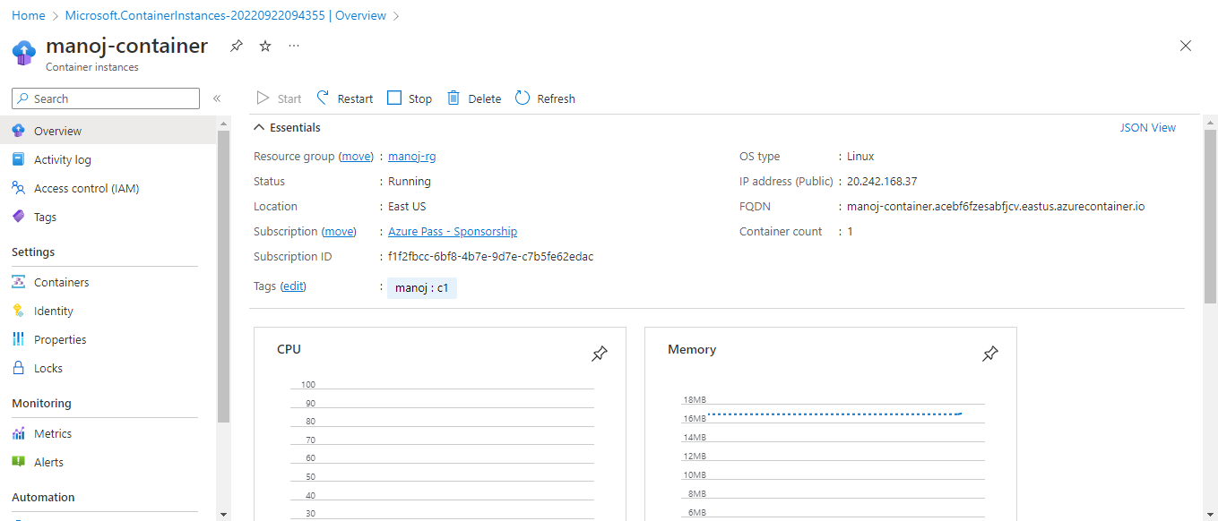

Slide 55
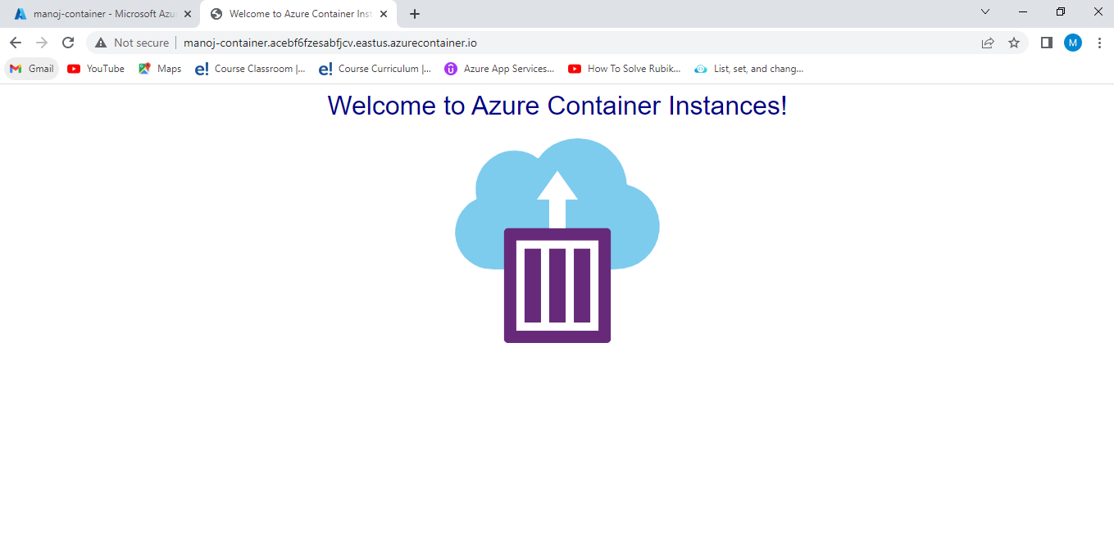
Open the overview for the container group by navigating to ResourceGroups > manoj-rg> manoj-container. Make a note of the FQDN of the container instance and its Status.

Slide 56
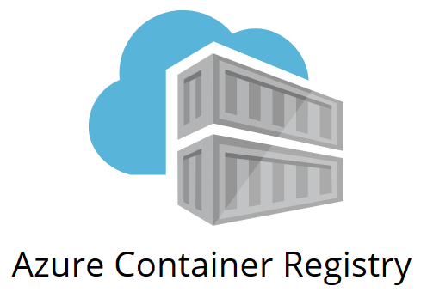

Slide 57
The Azure container registry is Microsoft's own hosting platform for Docker images. It is a private registry where you can store and manage private docker container images and other related artifacts
Azure Container Registry allows you to build, store, and manage container images and artifacts in a private registry for all types of container deployments. Use Azure container registries with your existing container development and deployment pipelines.
A container registry is a repository—or collection of repositories—used to store and access container images. Container registries can support container-based application development, often as part of DevOps processes.

Slide 58
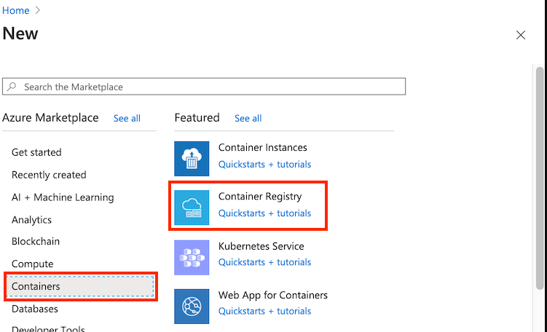
Lab5: Create Azure Container Registry
Select Create a resource > Containers > Container Registry.

Slide 59
In the Basics tab, enter values for Resource group and Registry name. The registry name must be unique within Azure, and contain 5-50 alphanumeric characters
For this quickstart create a new resource group in the West US location named manoj-rg, and for SKU, select 'Basic'.

Slide 60
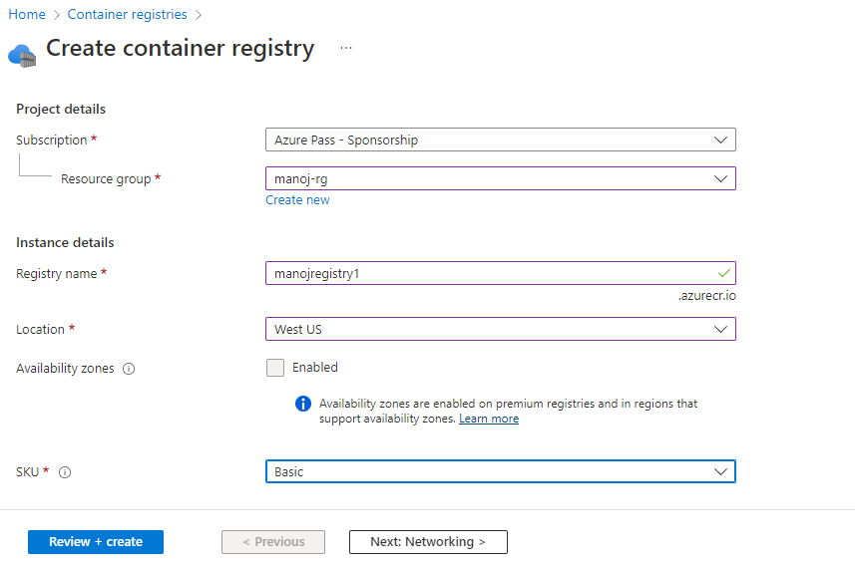

Slide 61
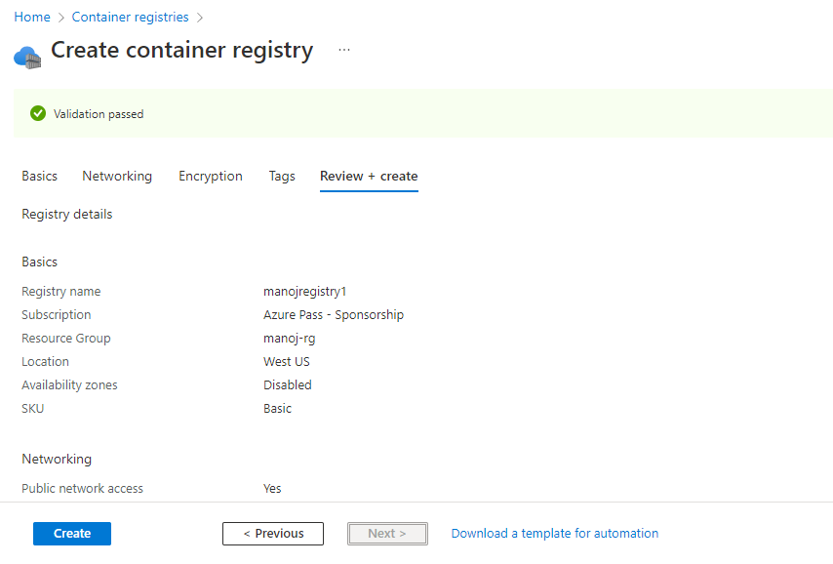
Accept default values for the remaining settings. Then select Review + create. After reviewing the settings, select Create

Slide 62
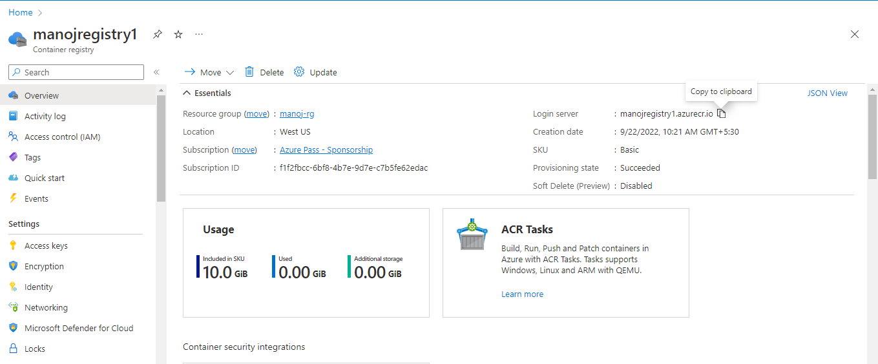
When the Deployment succeeded message appears, select the container registry in the portal.

